Slide 1
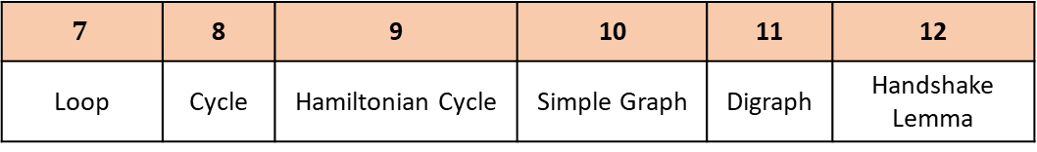
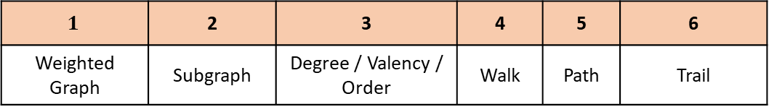
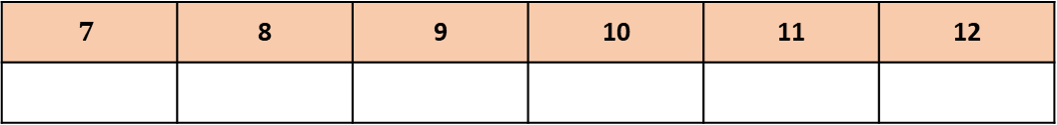
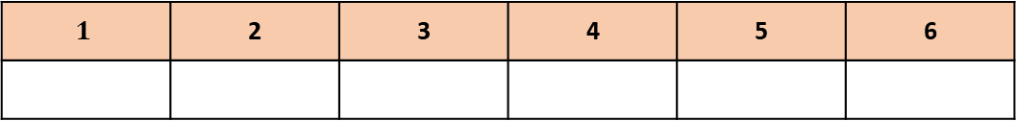
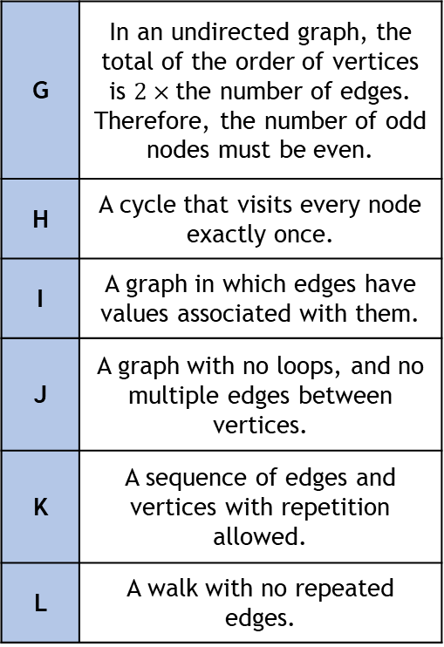
Graph Theory Key Terms Match-Up
$$1$$ | 2 | 3 | 4 | 5 | 6
Weighted Graph | Subgraph | Degree / Valency / Order | Walk | Path | Trail
$$7$$ | 8 | 9 | 10 | 11 | 12
Loop | Cycle | Hamiltonian Cycle | Simple Graph | Digraph | Handshake Lemma
A | A walk with no repeated vertices.
B | The number of edges incident to a node.
C | An edge that starts and end at the same vertex.
D | A graph formed from a subset of vertices and edges of another graph.
E | A closed path – starts and ends at the same vertex with no other repeats.
F | A graph with at least one direction on an edge.
G | In an undirected graph, the total of the order of vertices is $2×$the number of edges. Therefore, the number of odd nodes must be even.
H | A cycle that visits every node exactly once.
I | A graph in which edges have values associated with them.
J | A graph with no loops, and no multiple edges between vertices.
K | A sequence of edges and vertices with repetition allowed.
L | A walk with no repeated edges.
Answer Box
$$1$$ | 2 | 3 | 4 | 5 | 6
$$7$$ | 8 | 9 | 10 | 11 | 12

Slide 2
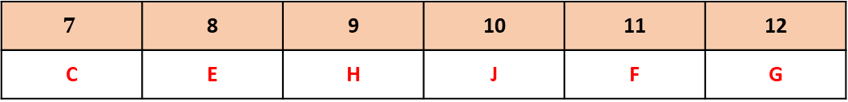
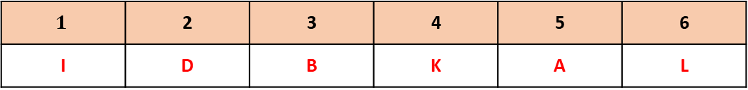
Graph Theory Key Terms Match-Up
$$1$$ | 2 | 3 | 4 | 5 | 6
Weighted Graph | Subgraph | Degree / Valency / Order | Walk | Path | Trail
$$7$$ | 8 | 9 | 10 | 11 | 12
Loop | Cycle | Hamiltonian Cycle | Simple Graph | Digraph | Handshake Lemma
A | A walk with no repeated vertices.
B | The number of edges incident to a node.
C | An edge that starts and end at the same vertex.
D | A graph formed from a subset of vertices and edges of another graph.
E | A closed path – starts and ends at the same vertex with no other repeats.
F | A graph with at least one direction on an edge.
G | In an undirected graph, the total of the order of vertices is $2×$the number of edges. Therefore, the number of odd nodes must be even.
H | A cycle that visits every node exactly once.
I | A graph in which edges have values associated with them.
J | A graph with no loops, and no multiple edges between vertices.
K | A sequence of edges and vertices with repetition allowed.
L | A walk with no repeated edges.
Answer Box
$$1$$ | 2 | 3 | 4 | 5 | 6
I | D | B | K | A | L
$$7$$ | 8 | 9 | 10 | 11 | 12
C | E | H | J | F | G

