Slide 1
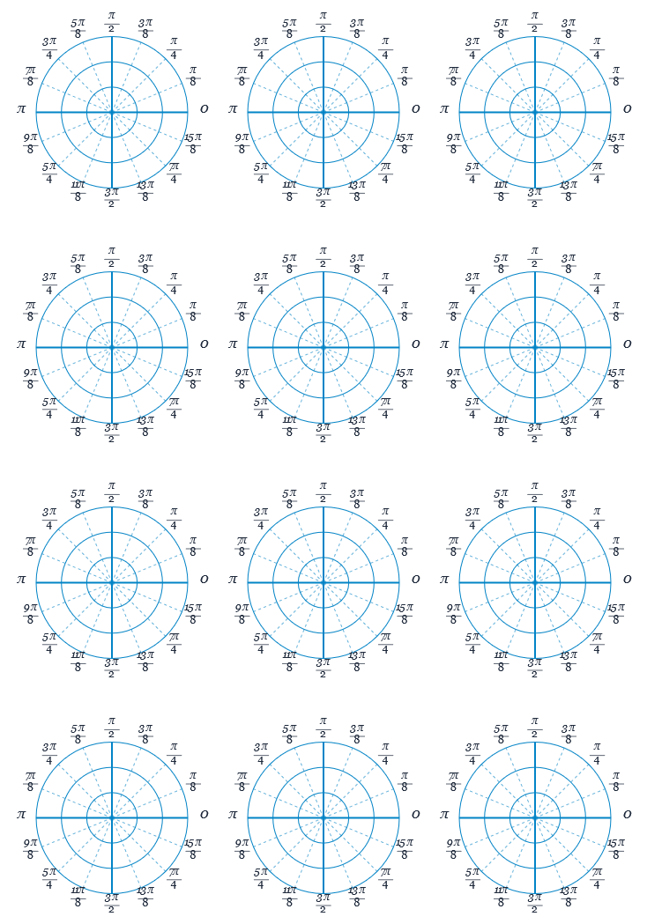












Polar Sketches
$$r=a$$
$$θ=a$$
$$r=2a\cos{θ}$$
$$r=kθ$$
$$r=a\cos{2θ}$$
$$r^{2}=a^{2}\cos^{2}{2θ}$$
$$r=a(1+cosθ)$$
$$r=a(1−\cos{θ})$$
$$r=a(3+2\cos{θ} )$$
$$r=a(12+3cosθ)$$
$$r=a\sec{θ}$$
$$r=p sec⁡(α−θ)$$

