Slide 1
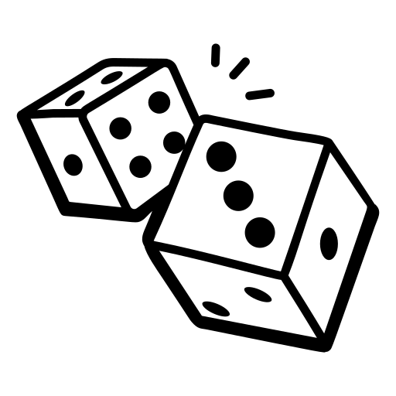
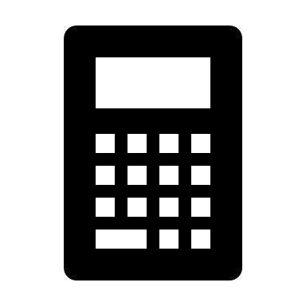




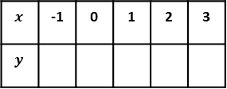

Roll 2 dice to choose the question
REVISION DICE GAME!
 | 1 | 2 | 3 | 4 | 5 | 6
1 | Write down the value of the 7 in the number 4,732. | Work out $$\frac{3.4×5.2}{{1.6}^{2}}$$ Write down every digit on your calculator display. | The mean of 4 numbers is 6 Three of the numbers are 4, 7, and 5 Find the other number | Order the following decimals from smallest to largest: 0.4, 0.415, 0.045, 0.45. | Write down a prime number between 20 and 30. | A train leaves London at 14:35 and arrives in Hitchin at 16:50. How long did the journey take in hours and minutes?
2 | A solid copper block has a mass of $240$g and a volume of $30$cm³. Find the density | In a class of 30 students, 12 are boys. 8 of the boys play football. 15 students in total play football. How many girls do not play football? | Work out $$2\frac{1}{4}+1\frac{2}{3}$$ Give your answer as a mixed number | Solve $$10−x=3$$ | Find the value of $x$ | Express 60 as a product of its prime factors
3 | A jacket was £40, and is reduced to £34 in a sale. Calculate the percentage decrease in the sale. | Increase £450 by 12% | A television costs £360 AFTER a 20% discount. What was the original price, before the sale? | Simplify the ratio $$8:24:36$$ | Write the ratio $5:12$in the form $1:n$ | The first three terms of a Fibonacci sequence are 2, 5, 7 Find the sixth term
4 | Solve $$3x−4<11$$ | Write $0.35$as a fraction in its simplest form. | £2000 is invested in a bank account paying 3% compound interest per year. How much is in the account after 3 years? | $$y=x^{2}+2x−3$$ Fill in the table | Work out $23\%$of $320$kg | The area of this circle is $201$cm². Find $r$
5 | I think of a number and multiply it by 3, then add 5. The result is 26. What was my number? | Round 45.682 to 1 decimal place. | Shade $A∩B$ | Find the Lowest Common Multiple (LCM) of 12 and 45 | Solve $4\left(x−2\right)=20$ | Factorise fully $$25x^{2}+35x$$
6 | Find $\frac{3}{8}$ of £24,000 | $p=4$and $q=−3$ Find the value of $$2p−3q$$ | Simplify $$3x+4y−x+2y$$ | A pen costs £1.45 How much change would you get from £10 if you buy 4 pens? | Expand and simplify $$(x+4)(x−3)$$ | Find the value of $x$
20 cm
25 cm
x cm
$$x$$ | -1 | 0 | 1 | 2 | 3
$$y$$
$$r$$
A
B
$$50$$
$$x$$
$60°$

