Slide 1
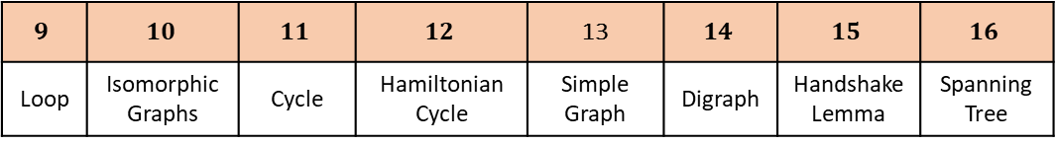
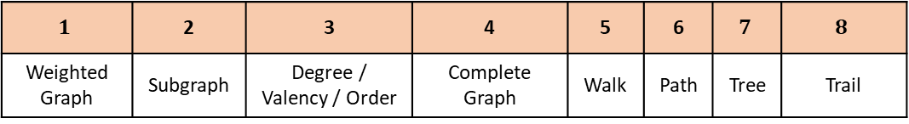
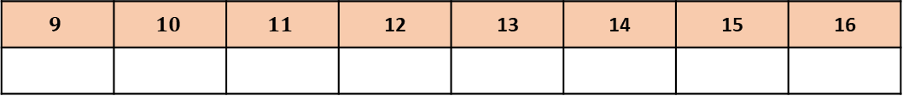
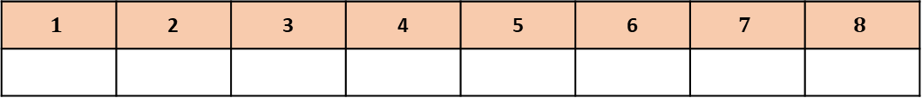
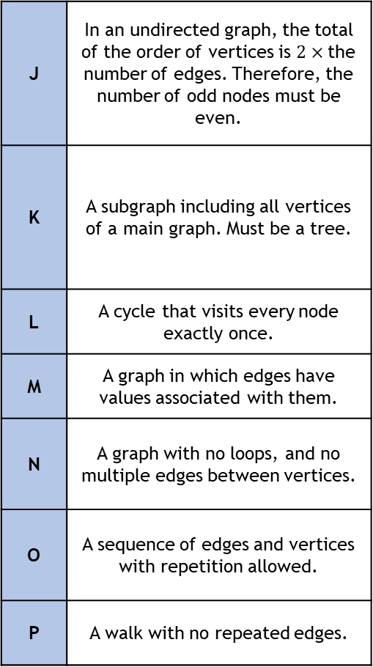
Graph Theory Key Terms Match-Up
$$1$$ | 2 | 3 | 4 | 5 | 6 | $$7$$ | $$8$$
Weighted Graph | Subgraph | Degree / Valency / Order | Complete Graph | Walk | Path | Tree | Trail
$$9$$ | $$10$$ | $$11$$ | $$12$$ | 13 | $$14$$ | $$15$$ | $$16$$
Loop | Isomorphic Graphs | Cycle | Hamiltonian Cycle | Simple Graph | Digraph | Handshake Lemma | Spanning Tree
A | A walk with no repeated vertices.
B | A graph in which every vertex is connected to every other vertex by a single edge.
C | The number of edges incident to a node.
D | An edge that starts and end at the same vertex.
E | A connected graph with no cycles.
F | A graph formed from a subset of vertices and edges of another graph.
G | A closed path – starts and ends at the same vertex with no other repeats.
H | A graph with at least one direction on an edge.
I | Versions of the same graph drawn differently.
J | In an undirected graph, the total of the order of vertices is $2×$the number of edges. Therefore, the number of odd nodes must be even.
K | A subgraph including all vertices of a main graph. Must be a tree.
L | A cycle that visits every node exactly once.
M | A graph in which edges have values associated with them.
N | A graph with no loops, and no multiple edges between vertices.
O | A sequence of edges and vertices with repetition allowed.
P | A walk with no repeated edges.
Answer Box
$$1$$ | 2 | 3 | 4 | 5 | 6 | $$7$$ | $$8$$
$$9$$ | $$10$$ | $$11$$ | 12 | 13 | 14 | 15 | 16

Slide 2
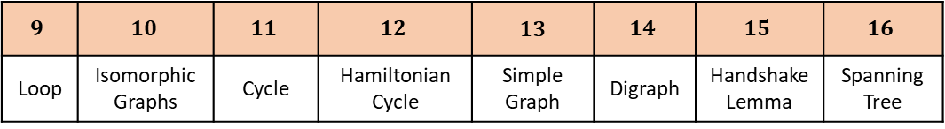
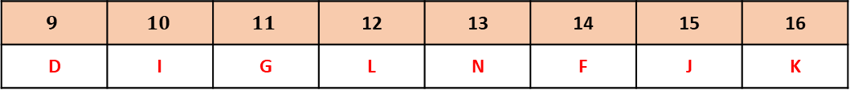
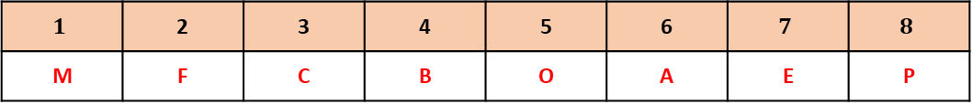
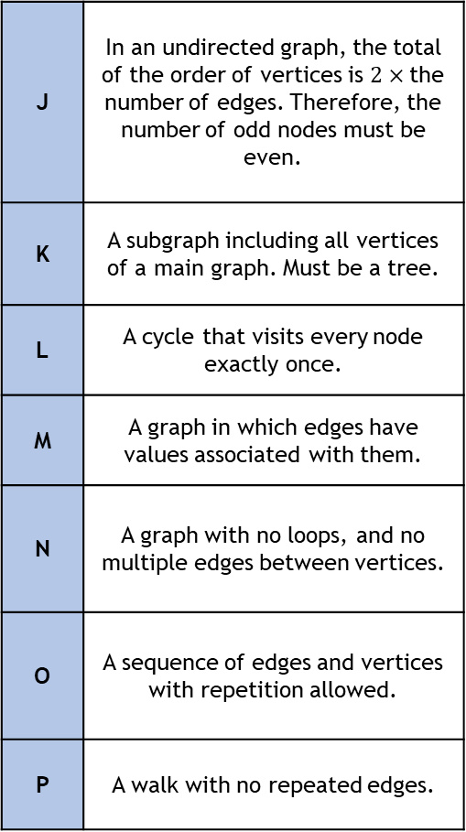
Graph Theory Key Terms Match-Up
$$1$$ | 2 | 3 | 4 | 5 | 6 | $$7$$ | $$8$$
Weighted Graph | Subgraph | Degree / Valency / Order | Complete Graph | Walk | Path | Tree | Trail
$$9$$ | $$10$$ | $$11$$ | $$12$$ | 13 | $$14$$ | $$15$$ | $$16$$
Loop | Isomorphic Graphs | Cycle | Hamiltonian Cycle | Simple Graph | Digraph | Handshake Lemma | Spanning Tree
A | A walk with no repeated vertices.
B | A graph in which every vertex is connected to every other vertex by a single edge.
C | The number of edges incident to a node.
D | An edge that starts and end at the same vertex.
E | A connected graph with no cycles.
F | A graph formed from a subset of vertices and edges of another graph.
G | A closed path – starts and ends at the same vertex with no other repeats.
H | A graph with at least one direction on an edge.
I | Versions of the same graph drawn differently.
J | In an undirected graph, the total of the order of vertices is $2×$the number of edges. Therefore, the number of odd nodes must be even.
K | A subgraph including all vertices of a main graph. Must be a tree.
L | A cycle that visits every node exactly once.
M | A graph in which edges have values associated with them.
N | A graph with no loops, and no multiple edges between vertices.
O | A sequence of edges and vertices with repetition allowed.
P | A walk with no repeated edges.
Answer Box
$$1$$ | 2 | 3 | 4 | 5 | 6 | $$7$$ | $$8$$
M | F | C | B | O | A | E | P
$$9$$ | $$10$$ | $$11$$ | 12 | 13 | 14 | 15 | 16
D | I | G | L | N | F | J | K

