Slide 1


Constructing a Perpendicular Bisector Storyboard
$1.$ | $2.$
$3.$ | $$4.$$

Slide 2
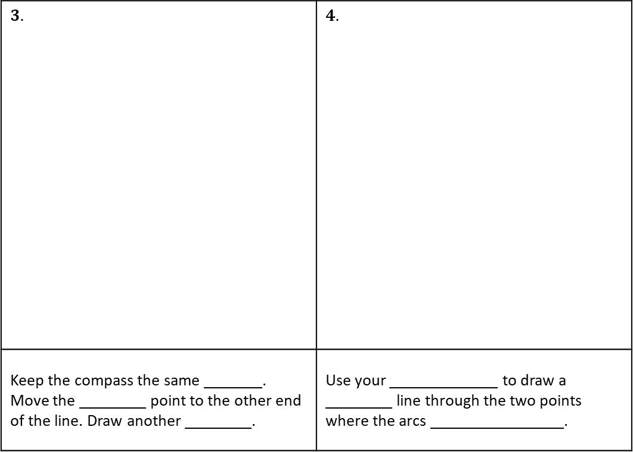
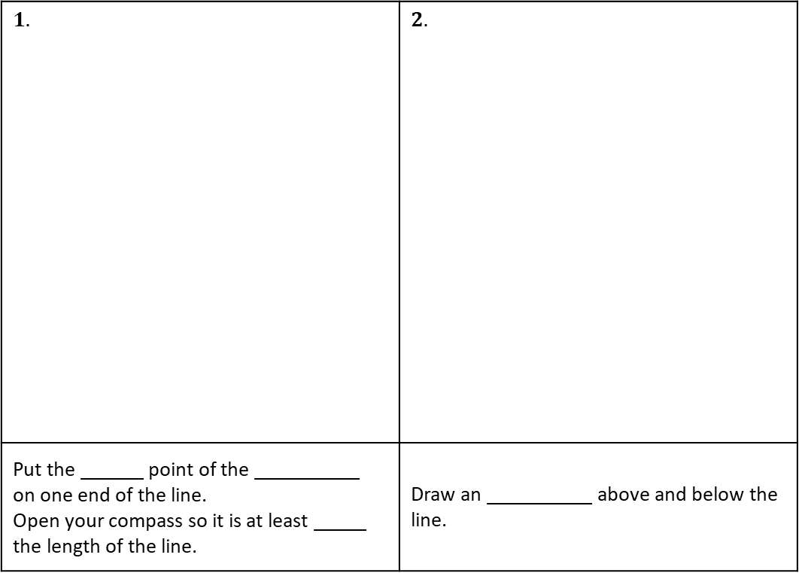
Constructing a Perpendicular Bisector Storyboard
$1.$ | $2.$
Put the ______ point of the __________ on one end of the line. Open your compass so it is at least _____ the length of the line. | Draw an __________ above and below the line.
$3.$ | $$4.$$
Keep the compass the same _______. Move the ________ point to the other end of the line. Draw another ________. | Use your _____________ to draw a ________ line through the two points where the arcs ________________.

Slide 3
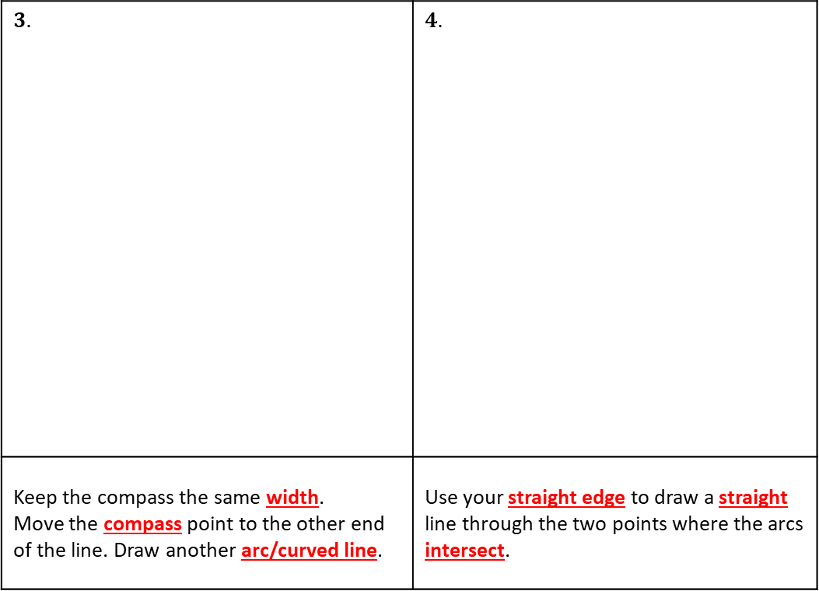
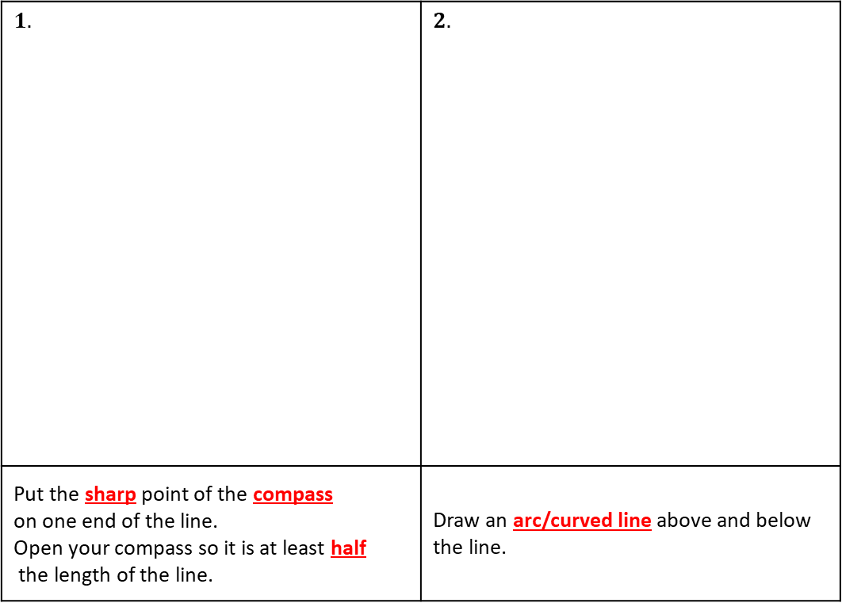
Constructing a Perpendicular Bisector Storyboard
$1.$ | $2.$
Put the sharp point of the compass on one end of the line. Open your compass so it is at least half the length of the line. | Draw an arc/curved line above and below the line.
$3.$ | $$4.$$
Keep the compass the same width. Move the compass point to the other end of the line. Draw another arc/curved line. | Use your straight edge to draw a straight line through the two points where the arcs intersect.

